Slide 1
Employee Data Analysis using Excel
STUDENT NAME:V.Priya
REGISTER NO:asunm110312201379
DEPARTMENT:B.com(general)
COLLEGE:DRBCCC Hindu college

Slide 2
PROJECT TITLE
Employee Performance Analysis using Excel

Slide 3


AGENDA
Problem Statement
Project Overview
End Users
Our Solution and Proposition
Dataset Description
Modelling Approach
Results and Discussion
Conclusion
3/21/2024 Annual Review

Slide 4

PROBLEM STATEMENT
A problem statement is a document that outlines a specific problem in an organization. For instance, problem statements often refer to inefficiencies in a given workplace process that hinder progress in a project or task.
But a problem statement is more than a simple statement of the problem. Problem statements provide viable solutions, allowing management to launch an improvement project and solve the problem.
Problem statements come from all sorts of employees. A team member’s point of view helps management gain a higher-resolution picture of the problem from a hands-on level.

Slide 5

PROJECT OVERVIEW
Annual salary information including gross pay and overtime pay for all active, permanent employees of Montgomery County, MD paid in calendar year 2023. This dataset is a prime candidate for conducting analyses on salary disparities, the relationship between department/division and salary, and the distribution of salaries across gender and grade levels.
Statistical models can be applied to predict base salaries based on factors such as department, grade, and length of service. Machine learning techniques could also be employed to identify patterns and anomalies in the salary data, such as outliers or instances of significant inequity.

Slide 6

WHO ARE THE END USERS?
Production is the process of converting raw materials into finished products for consumption by the end-user. So, what does end-user mean?
In order to understand who are end users, it is important to consider how the supply chain works. Accordingly, delivering goods or services to the end-user is the last step in the supply chain. Based on this clarification, the end user, also known as the end consumer, is the person who ultimately consumes a finished product. In other words, the end customer is the last consumer of a product or service. For example, grocery shoppers who buy farm produce for food are excellent examples of end-users.

Slide 7

OUR SOLUTION AND ITS VALUE PROPOSITION
An employee value proposition is the unique value you offer as an employer to your employees in return for their skills, experience, and commitment to your company. This includes components like salary, benefits, rewards, career development, and work-life balance, as well as your values, mission, social purpose, and organizational culture.
Essentially, your EVP aims to identify and communicate all the unique benefits and experiences that employees can expect

Slide 8
Dataset Description
Employee salary datasets can contain information about employee salaries, job titles, and other variables. The data can be used to analyze relationships between variables and predict salaries, or to gain insights into job market trends. Here are some examples of employee salary datasets:
Salary Prediction dataset
This dataset contains information about employee salaries, including age, gender, education level, job title, years of experience, and salary. It can be used to analyze the relationship between these variables and predict salaries.

Slide 9
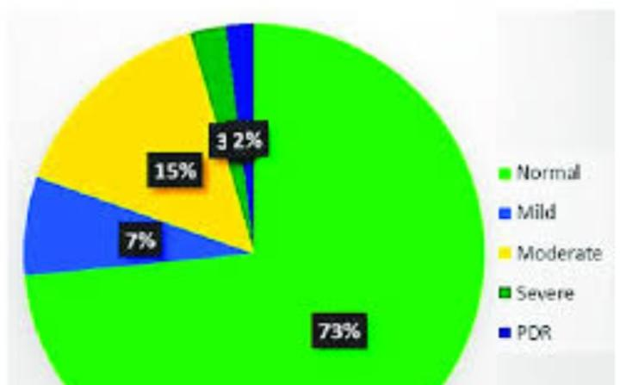
Dataset Description

Slide 10


THE "WOW" IN OUR SOLUTION
A Guide to Compensation Analysis
Compensation analysis is vital to providing fair, equitable compensation. Smart organizations know that providing the right compensation is one of the key pillars to attract and retain the best talent. A thorough compensation analysis provides the data and insights for critical decisions as it relates to salaries and total benefits for employees.
3/21/2024 Annual Review
10

Slide 11

MODELLING
Modeling Employee Performance Analysis
The task of the model is simple, that is to replicate how employees will perform given several variables. As we all know, employees are humans, and their performance depends on a spectrum of variables. The list could include how satisfied they are with the current work environment (e.g., bosses, co-workers, work-life balance, etc.), the experience that they have, the training and education background that support them on the job, the way they commute, and so on.
11

Slide 12
Results
Enhance Performance with Data Analytics
In today's competitive business landscape, accurate and objective measurement of employees' performance is crucial for organizational success. Traditional methods of performance measurement often fall short in providing a comprehensive understanding of employees' contributions and potential areas for improvement. This is where data analytics comes into play. By leveraging advanced technologies and analytical techniques, data analytics can revolutionize the way organizations measure employee performance.

Slide 13
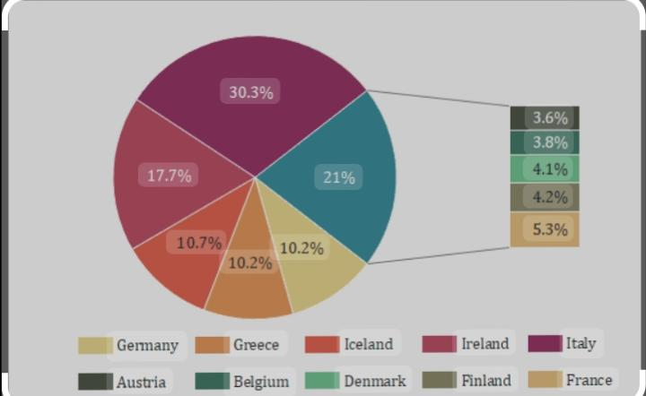
Results

Slide 14
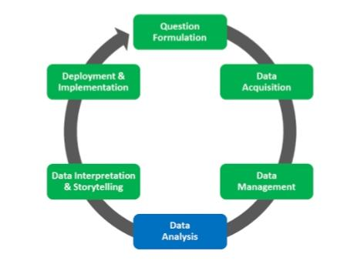
Conclusion
These conclusions are usually listed numerically, and then further discussed one by one. The reasoning followed to reach the conclusions and the data that supports the statements made are incorporated into a brief editorial comment with respect to the global interpretation.
It is absolutely critical at this point not to cede to temptation to make concluding statements that would apply the study’s results beyond the parameters established for the study under the problem definition. Indeed, you may even want to incorporate a statement warning the reader not to interpret the results in such a way that generalizations beyond the study’s parameters are made.

